Slide 1
Catering Robot
Course Project: BITS F327 Artificial Intelligence for Robotics

Slide 2
Acknowledgements
We would like to thank Dr. Abhishek Sarkar for his valuable guidance and support. We would also like to thank Mr. Suryanarayana for his support and assistance.

Slide 3
Introduction
As human living standards keep on improving continuously, robots gradually entered our daily lives to make things easier and interesting. Out of these service robots, catering robots are one of the most interesting and useful robots.
In 1983, The Two Panda Deli in Pasadena, California became the first restaurant to employ two catering robots, Tanbo R-1 and Tanbo R-2 as their staff, in order to bring chinese food to their customers and entertain them with friendly jokes and music.
Catering service robots working in restaurants are usually integrated with multi sensor data fusions, autonomous mobile and multimodal human computer interaction techniques.
They can partially or completely take the role of restaurant staff as they can be used by customers for ordering food and provide delivering services in the restaurant along with friendly interactions and self mobility.
Hence they are very beneficial, as they come with good marketing effectiveness and potential profitable advantages.
Commercial waiter robots can go up to $10,000. For example, BellaBot.
Therefore, in our project, introducing uncertainty into the environment and path planning along with course correction can be useful if deployed.

Slide 4
Theory and Algorithms used
We use a pre-built robot kit with the necessary tools and functions as well as the simulation environment tools by Brian Blais from Bryant University (https://github.com/bblais) for our project.
It allows the user to build basic 2D robots of various shapes. The robot has a list of functions that allows us to build various new functions for motion and path planning.
It involves a simulation environment built with box2d and visualization with matplotlib.
pybox2d is a 2D physics library for your games and simple simulations. It's based on the Box2D library, written in C++. It supports several shape types (circle, polygon, thin line segments), and quite a few joint types (revolute, prismatic, wheel, etc.).
Matplotlib is a comprehensive plotting library for creating static, animated, and interactive visualizations in Python.

Slide 5
Theory and Algorithms used (Cont’d…)
We then implement path planning using D* Lite algorithm. It is useful for our use case as it is a simpler version of D* while also allow for course correction by replanning the path as obstacles are encountered.
D* Lite is an incremental heuristic search that repeatedly determines shortest paths between the current node of the robot and the goal node as the edge costs of a graph change while the robot moves towards the goal node. It is based upon the idea as A*. It adapts to obstacles with minimum cost to reach the goal.
Autonomous robots are the ones that act without recourse to human control and show some degree of self sufficiency.
The first autonomous robot environment known as Elmer and Elsie were first constructed in the late 1940s by Grey Walter.

Slide 6
Theory and Algorithms used (Cont’d…)
The Finite State Machine is an abstract mathematical model of a sequential logic function and can be implemented in real life circuits with the help of Flip Flops. It has finite inputs, outputs and number of states. It can change from one state to another as response to some inputs.
The robotic controller acts as the brain of a robot as it usually interrupts coding that serves as the program for a given robotic application. It deciphers the code into instructions for the articulated robot to use in order to operate and carry out the steps of application.

Slide 7
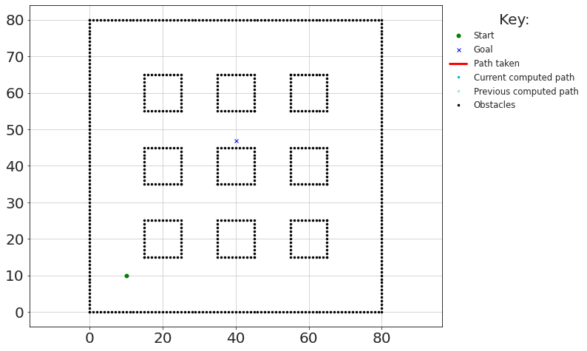
Simulation Details
In this environment, 9 tables are used as shown: each having 10*10 unit^2 area
Overall square boundary :80*80 unit^2
Cost of motion from one node to next (i.e one point to another) is either 1 or sqrt(2).
Coordinates can only be integers.

Slide 8
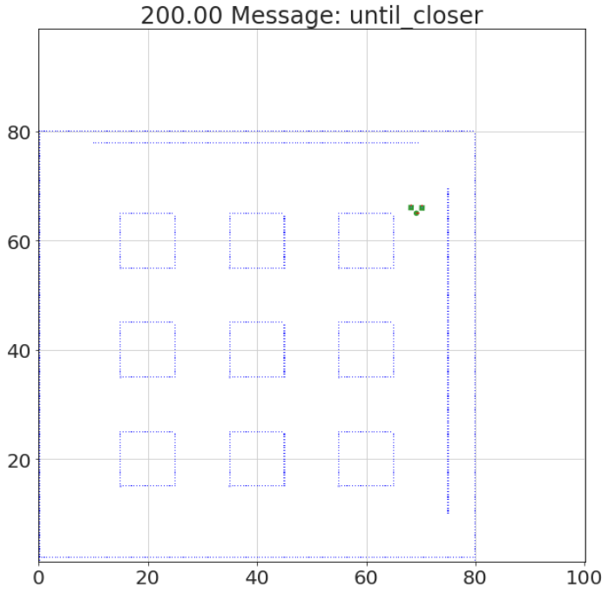
Simulation Details (Cont’d…)
The environment is build with box2d and matplotlib. It’s dimensions are 100*100 unit^2
Robot dimensions:
Both boxes => 1*1 unit^2
Disk => pi*(0.5)^2 unit^2
Table dimensions:
10*10 unit^2
Obstacle dimensions:
60*0.2 unit^2
Currently, the obstacles are static.
Run time is 200; detail display is 5.

Slide 9

Preliminary Results
There are 9 tables and 4 seats each; 36 possible goal nodes and they are randomly selected.
After initial path is computed, two random obstacles are introduced after some initial movement; one along x axis and one along y axis.
Obstacles are randomly introduces from a set of 6 possible obstacles we have defined.
The path is then recomputed.
Final path is obtained.

Slide 10
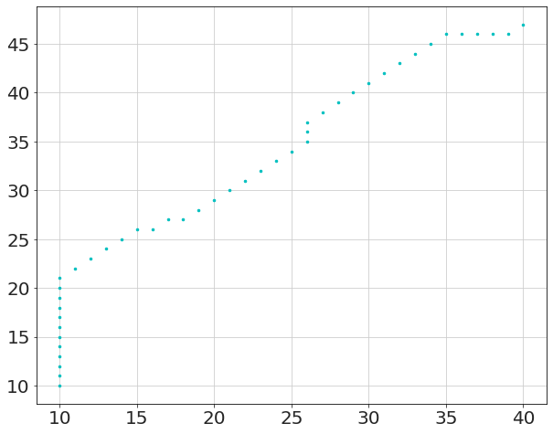
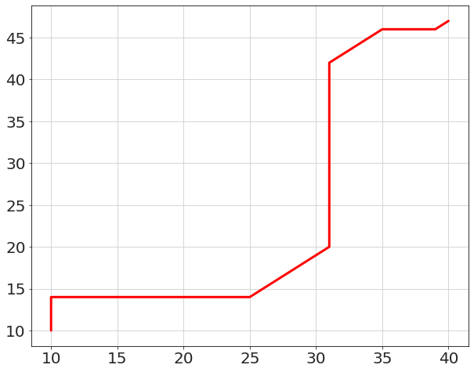
Preliminary Results (Cont’d…)
Example:
Initial path before obstacles were introduced
Course corrected path after obstacle was discovered

Slide 11
Preliminary Results (Cont’d…)
The robot starts at (10,10) and moves forward until it detects an obstacle.
The different states of the robots are by functions in a finite state machine.
It continuously measures the distance of the obstacle that is in front of it.
If the obstacle distance<8 units, the robot stops.

Slide 12
Preliminary Results (Cont’d…)
It then checks to its left and right and saves these distances.
It then looks straight and then based on the previous data, chooses to move left or right.
The robot then turn 90 degrees towards the predicted direction and moves forward once again.
This process takes place again and again until then end of run time.

Slide 13
Next Steps
Improve the robot simulation and its functions and avoid obstacle collision.
Implement the planned path into the simulation.
Introduce multiple iterations into path planning such that new start point is the previous end point.
Have multiple seats be occupied (multiple goal nodes) in a single interval.
Introduce more uncertainty into the environment such interval of seats being occupied being take place at irregular intervals of time.

Slide 14
References
https://www.researchgate.net/publication/251945230_Catering_Service_Robot
https://www.sciencedirect.com/science/article/pii/S1877050918309967
https://www.pudurobotics.com/product/detail/bellabot
http://idm-lab.org/bib/abstracts/papers/aaai02b.pdf
https://github.com/AtsushiSakai/PythonRobotics
https://github.com/bblais/RobotSim373

Slide 15
The Team
Ankit Ashok
Ayush Kasara
Sindhu Meghana

